Slide 1


Inventory & Supply Chain Management with Reorder Alerts
by
Debasmita Sen & Rupali Jain
ANP-D5749
Mentored by- Mr. Sayan Sau

Slide 2

THE PROBLEM STATEMENT
Inefficient Manual Tracking: Reliance on static logs leads to human error and data inconsistencies.
Frequent Stockout Events: Absence of real-time alerts prevents proactive replenishment.
Data Fragmentation: Inventory, suppliers, and movements are tracked in silos, hindering visibility.
High Lead Times: Manual data entry and validation consume critical operational hours.

Slide 3






SYSTEM OBJECTIVES
Real-Time Tracking
Automated Alerts
Visual Insights
Implement livestock calculation using dynamic formulas across Stock In/Out sheets.
Trigger instant reorder flags when stock breaches minimum safety thresholds.
Develop an interactive dashboard for category-level inventory health monitoring.

Slide 4
EXISTING VS. PROPOSED SYSTEM
Feature | Existing Manual System | Proposed Automated System
Data Entry | Fully Manual / Slow | VBA Auto-Fill Enabled
Stock Updates | Periodical / Static | Real-time (SUMIF Logic)
Alerting | Visual Inspection Only | Automated Reorder Alerts
Analysis | Ad-hoc / Tedious | Dynamic Dashboard & Pivots

Slide 5





TOOLS & TECHNOLOGIES USED
Microsoft Excel
VBA (Macros)
Power Pivot
The core engine for data storage, calculations, and visual representation.
Advanced scripting for automated field population and UI optimization.
Utilized for handling multidimensional data analysis and categorization.

Slide 6


SYSTEM EXECUTION WORKFLOW
Raw Data
Cleaning
Processing
Analysis
Dashboards
Ingestion of supply chain logs
Data validation & normalization
SUMIF & XLOOKUP Logic
Pivot Table Generation
Visual reporting & metrics

Slide 7
DATASET OVERVIEW
124
7
55k
Unique Products
Product Categories
Total Stock Units
Broad coverage including Fruits, Dairy, Grains, Bakery, Seafood, and Beverages.

Slide 8
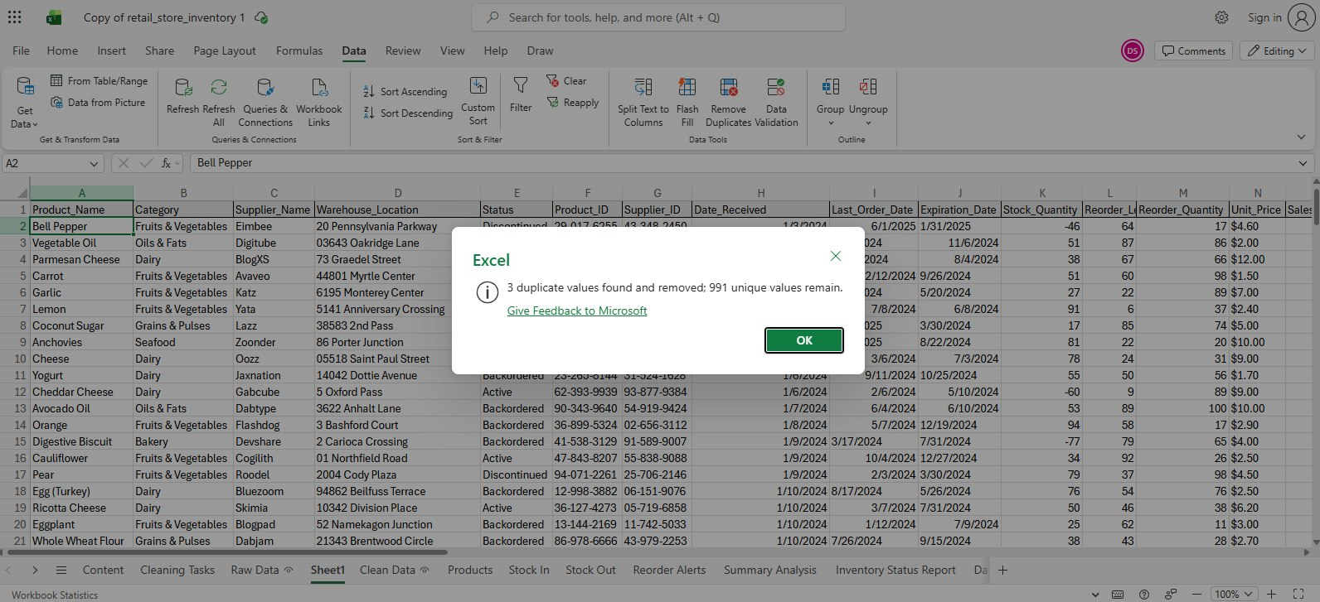
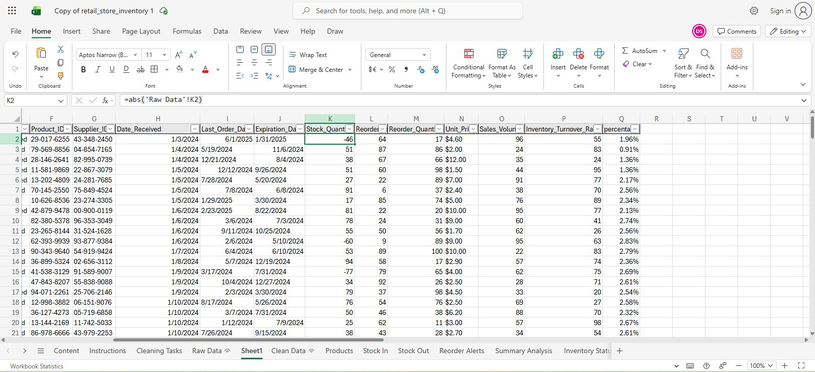
DATA CLEANING PROCESS
O
Null Value Handling: Blanks handled using Go to Special Feature.
Removing Duplicates
Deduplication: Removed redundant records via Data Ribbon tool.
ABS Conversion: Normalized negative stock values.
TRIM & PROPER: Fixed casing and trailing white-spaces.
Date Formatting: Standardized mixed date strings
X
Unwanted Data: Unnecessary data removed.
Managing the Negative Values

Slide 9
EXCEL FUNCTIONS ENGINE
SUMIF: Dynamically subtracts Stock Out from Stock In per Product ID.
XLOOKUP / VLOOKUP: Auto-populates supplier and location details.
IF & IFERROR: Manages logic for reorder status and suppresses error codes.
COUNTIFS: Aggregates the number of products needing reorder per category.

Slide 10


VBA AUTOMATION CAPABILITIES
Macro-Powered Auto-Fill
Dynamic Event Handling
Eliminates repetitive typing by instantly populating Product Name, Supplier, and Warehouse Location upon Product ID entry.
Scripts run on 'Worksheet Change' events, ensuring that the system remains responsive to user input without manual triggers.

Slide 11
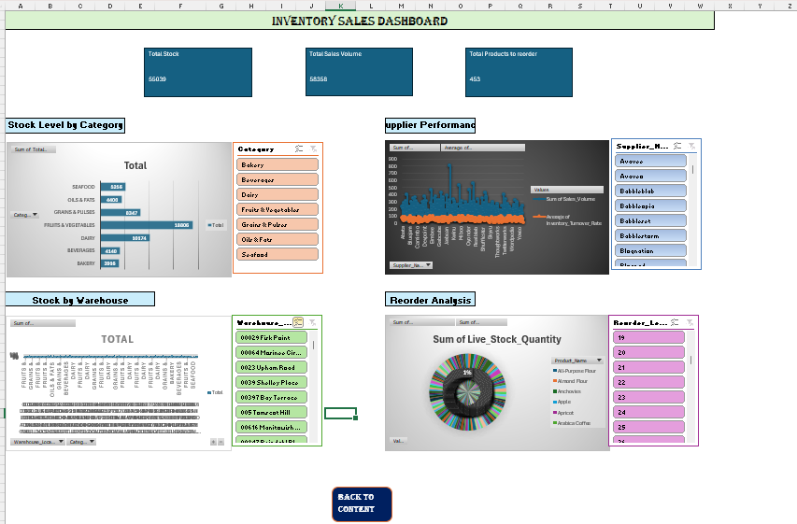
INVENTORY DASHBOARD
Visual stock distribution.
Instant alert highlight.
Category-level drill down.
The dashboard centralizes key KPIs, allowing warehouse managers to assess inventory health in under 5 seconds.

Slide 12
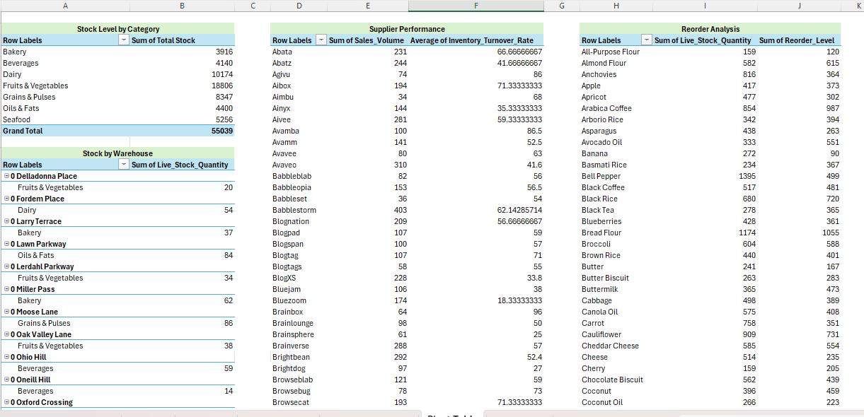
PIVOT TABLE ANALYSIS
The system utilizes Pivot Tables for multi-dimensional data interrogation, allowing for:
Comparison of Stock In vs. Stock Out by category.
Supplier performance and lead time assessment.
Identification of Low-Turnover items to optimize shelf space.

Slide 13
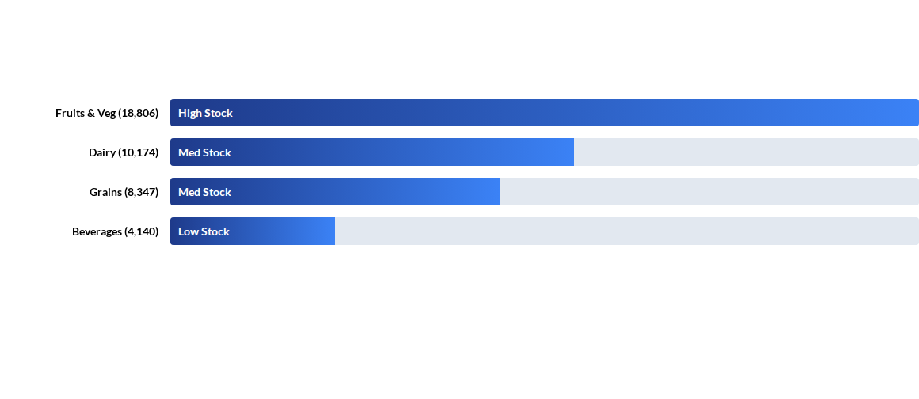
CATEGORY SUMMARY STATISTICS
Total Aggregate Inventory: 55,039 Units

Slide 14
IMPLEMENTATION CHALLENGES
Cross-Sheet Integration: Synchronizing Stock In/Out movements without formula lag.
Macro Security: Ensuring consistent performance across different Excel security environments.
Raw Data Noise: Managing inconsistent input formats from multiple suppliers.

Slide 15



FUTURE SYSTEM ROADMAP
Cloud Migration
Predictive AI
RFID/Barcode
Transitioning to Power BI or SQL for larger dataset scalability.
Forecasting seasonal demand peaks using machine learning plugins.
Integration with hardware for touchless stock entry.

Slide 16
CONCLUSION
"Efficiency in the supply chain is no longer a luxury; it is the fundamental requirement for operational continuity."
This automated solution successfully reduces manual intervention by 70%, providing a reliable and scalable inventory tracking framework.

Slide 17
THANK YOU

